Slide 1

Analysis on P2P success
——based on RenRenDai
Team member: Winnie Wang
Student ID：1701213097

Slide 2
Dataset
Over 9000 individual P2P samples on Renren dai website.
Lenders and borrowers match on this website.
RenRen Dai is one of the biggest online P2P website in China. It is honored as top 100 internet companies in both 2015 and 2016.

Slide 3
Dependent variable of the model:
Whether the P2P contract is successful or not
已流标
还款中
申请中
Whether the P2P contract is successful
status

Slide 4
Independent variables
Basic information about p2p contract
Basic information about borrower
Credit record of borrower
Brief introduction about the usage of money

Slide 5
Basic information about P2P contract
Principal (RMB)
Range: 3000-500000
Median: 43100
Interest rate
Range: 9.5%-24%
Median: 15%
Maturity (month)
Range: 3-36
Median: 18
Mean: 66027
Mean: 14.05%
Mean:17.52

Slide 6
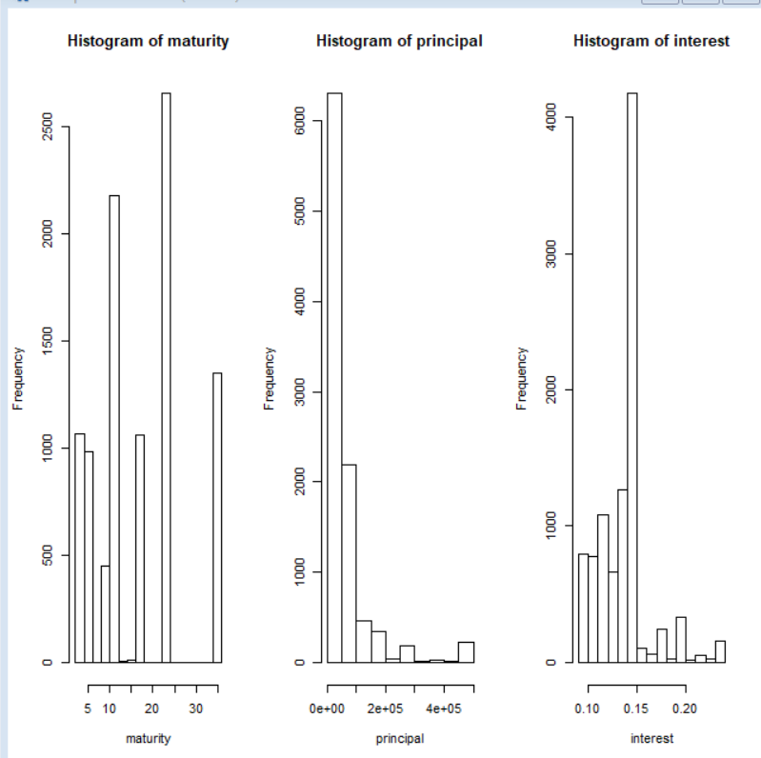

Slide 7

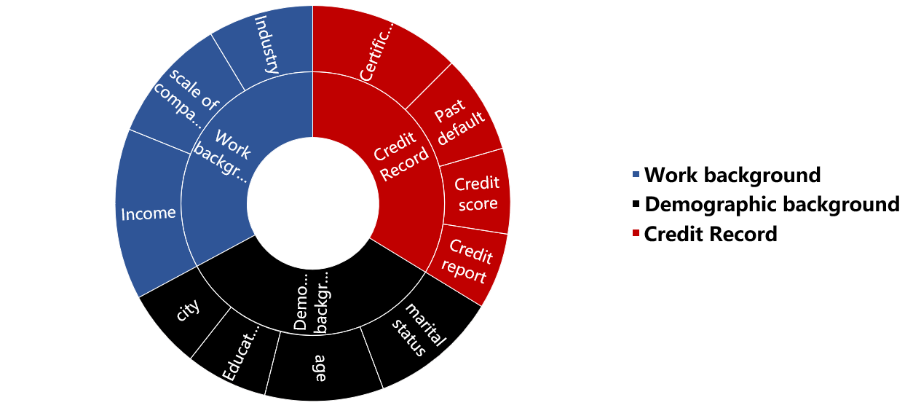
Basic information and credit record

Slide 8
Brief introduction of usage of money
Theory?
Familiarity
Availability
Method
Sentiment Analysis
Possible obstacles
Hard to decide gram
Hard to do word stemming

Slide 9
Thank you for your time!

